Slide 1
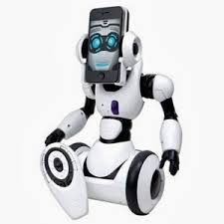

FACE RECOGONISATION SYSTEM FOR ROBOT APPLICATIONS
INTENDED BY
I.ELAMATHI
R.KAYATHIRI
Third year ,
Department of ECE
MAILAM ENGINEERING COLLEGE

Slide 2
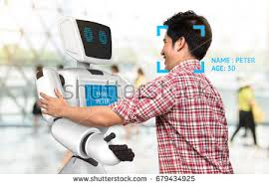
ABSTRACT
Face recognition system is used for the identification and verification of a face from a video or digital image. In the first phase, Viola Jones algorithm is used to detect and crop face region automatically from image/video frame. The second phase is to recognize the face of a person, in our proposed method Bag of Word technique used to extract features from an image which uses SURF for interest point selection, the proposed technique is tested on different state of the art face recognition databases and found more accurate and fast for face recognition.
Our proposed method recognizes more than two person faces, multi-class support vector machine is used to classify the face image and assign a class label based on the learning of the classifier. The algorithm for the detection and recognition of faces is implemented in MATLAB application, and achieves a high accuracy rate of 99.21, which will be tested on the mobile robot.

Slide 3
PROBLEM STATEMENT
The face recognition system may fail on poor lighting condition, long or small hairs, beard and glasses
Dissipate of time-Detection of landmarks is done after the detection of face, since it consume more time.
Lack of integral image and cascade classifier.

Slide 4
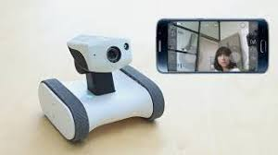
1.Face Detection Wheather there is a single or multiple faces or not and register it. 2.Features Extraction In this method local features of training images are extracted, speeded up robust features is a local feature descriptor that is used for object recognition 3.Classification Determining whether corresponding facial characteristics exists
PROPOSED SOLUTION

Slide 5
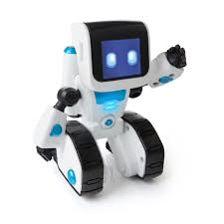
INTRODUCTION
Face recognition is becoming a multi-dispensary research area that has vast applications in robotics, the identification and verification of a person in a video or digital image
The human faces are different from each other as like finger prints and eye irises, the national academy of science addressed that face recognition is an important subject in biometrics
There are many algorithms for the automatic detection of facial, Viola Jones algorithms is one of the most popular algorithm for face detection.
A new technique Learned Local Gabor Patterns (LLGP) is used for face representation and recognition. This technique is based on Gabor features .

Slide 6
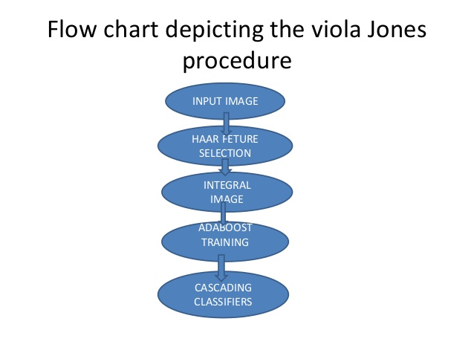
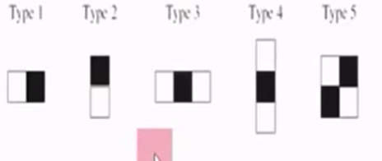
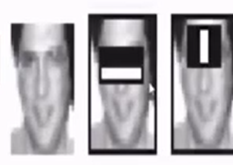
Viola jones techniques Haar features:
Haar features are similar to the convolution kernals which are use to detect the presence of that feature in a given image.
Each feature results in a single value which is calculated by subtracting a sum of pixels under a white rectangle from sum of pixels under black rectangle.
Haar features used in viola jones Applying on given image

Slide 7
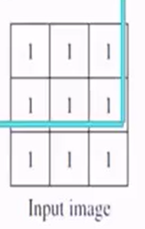
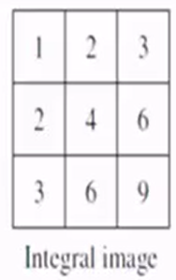
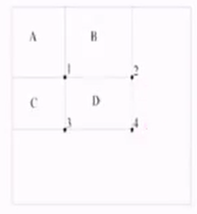
Intergal image:
In an integral image ,the value at pixel(x,y) is the sum of above and left of (x,y)
Sum of pixels in D=1+4-(2+3)
=A+(A+B+C+D)-(A+B+A+C)
=D

Slide 8
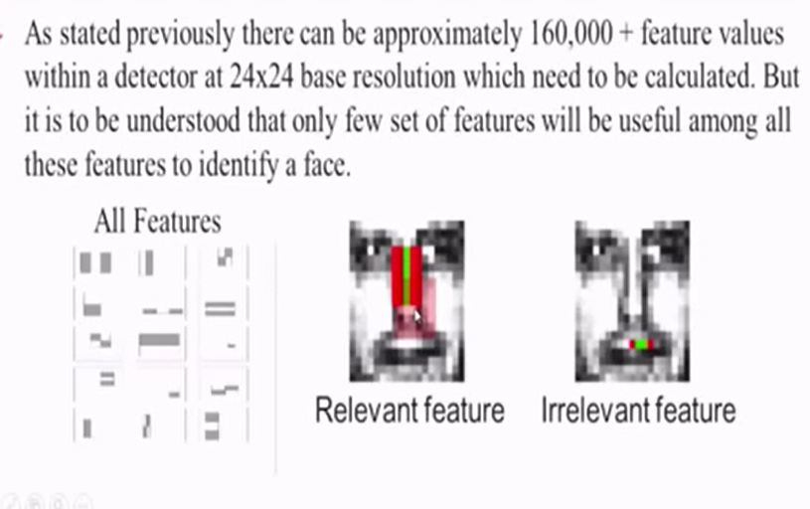
Adaboost:

Slide 9
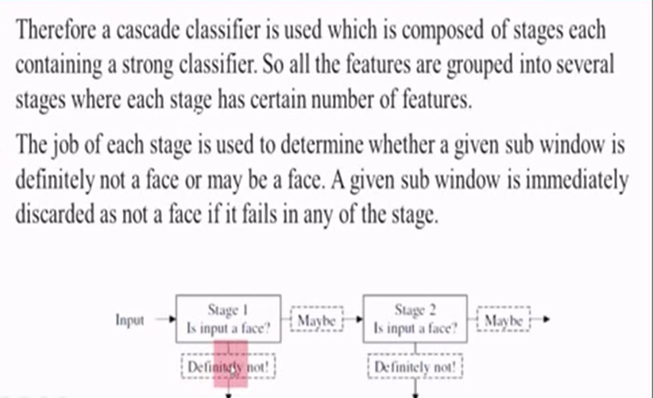
Cascade classifier:

Slide 10
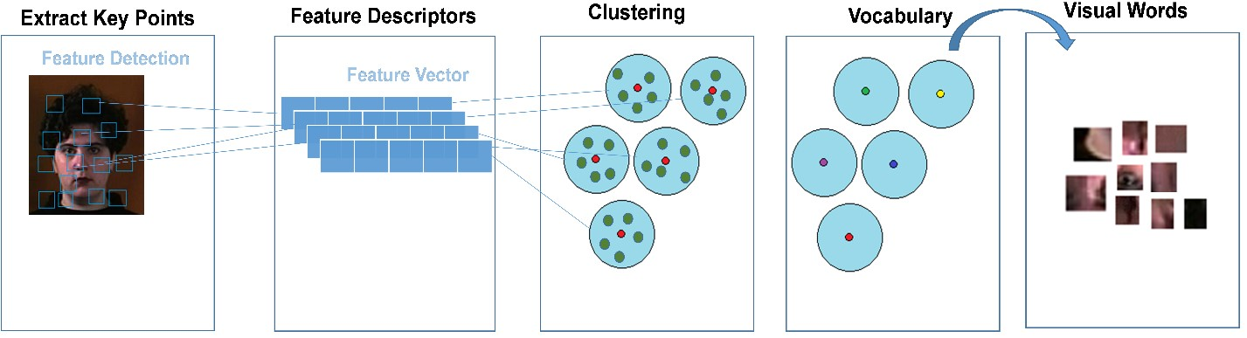
The point of interest selection is done using a grid with spacing [8x8], a vector of block width 32 pixels is created, where each element of the vector corresponds to a square block from where SURF features are extracted, multiple square blocks are used to extract multi-scale features. The points of interest are stored in feature vectors and these features are quantized using K-mean clustering algorithms, by default number of clusters used by bag of feature is five hundred that can be increased or decreased. Visual words are the centers of the clusters and vocabulary is the combination of all visual words, the features in vocabulary are categorized and a visual word is used to represent the category as described

Slide 11
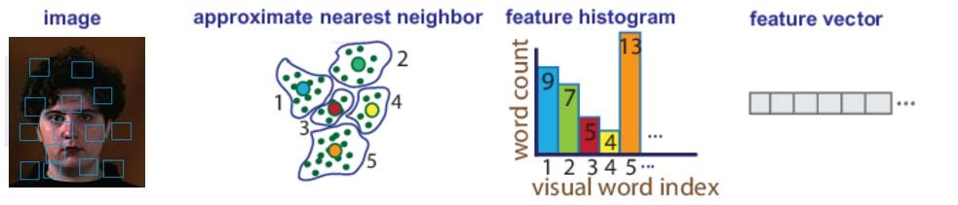
The multi-class SVM is trained using the error-correcting output code framework output code framework, multi-class SVM uses bag of features to encode images from the training set into histogram of visual words. These histograms are used to train the classifier; each image from the training dataset is encoded using the encoding scheme of bag of features algorithm, features from every image are detected and extracted and then features histogram of each training image is created with the help of an approximate nearest neighbour clustering algorithm. The length of the histogram is dependent on the number of visual words and a feature vector is created from the histogram.

Slide 12
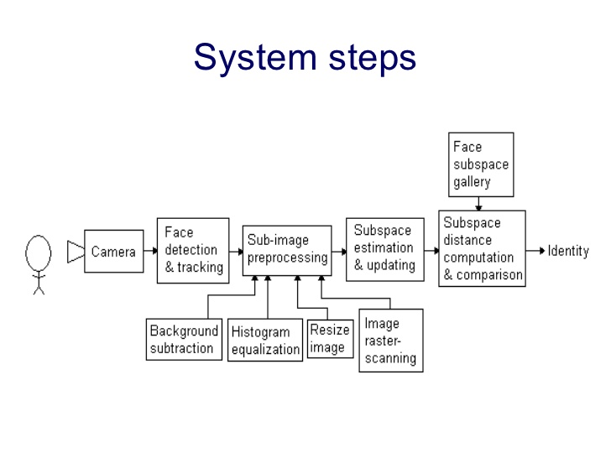

Slide 13
CONCLUSIONS
In our work, the face representation via bag of features for face recognition has been proposed, then linear SVM has been used for efficient classification of a face. In conventional BoW method SIFT features are used for creating dictionary, in our proposed method SIFT features are replaced with SURF features for fast and accurate features extraction. Extensive experiments demonstrate that the proposed method can achieve very good performance and outperforms most of state-of-the-art methods. we also have developed a local dataset of face images using raspberry pi camera, the system was trained with local created dataset and achieved a high accuracy of 99.21. It is also shown that, the proposed method can well handle different sizes of images as well as 1000 large number of categories, and make full use of a single image per subject for training. Moreover, it is very robust to the variations of expressions, illuminations and poses etc.
This work will be investigated to control the mobile robots like a wheelchair for disabled persons. The robot will successfully recognize the facial movement and move forward, backward, right, left and stopped when the movement of the user was detected.

Slide 14
REFERENCES
Y. Taigman, M. A. Ranzato, T. Aviv, and M. Park, “DeepFace : Closing the Gap to Human-Level Performance in Face Verification.” , pp. 1701-1708,2014.
R. Varun, Y. Vivekanand, K. Manikantan, and S. Ramachandran, “Face Recognition using Hough Transform based Feature Extraction,” Procedia - Procedia Comput. Sci., vol. 46, no. Icict 2014, pp. 1491– 1500, 2015.
M. Çar and F. Özen, “INSODE 2011 A Face Recognition System Based on Eigenfaces Method,” vol. 1, pp. 118–123, 2012.
G. Sitaram, S. Sarkar, K. Manikantan, and S. Ramachandran, “DWT feature extraction based face recognition using intensity mapped unsharp masking and laplacian of gaussian filtering with scalar multiplier,” vol. 6, pp. 475–484, 2012.

Slide 15
THANKING YOU

